Slide 1
GIT
R.P.Vijai Ganesh

Slide 2
GIT INTRODUCTION
Git is a modern and widely used distributed version control system in the world.
It is developed to manage projects with high speed and efficiency.
The version control system allows us to monitor and work together with our team members at the same workspace.

Slide 3
WHAT IS GIT
Git is an open-source distributed version control system. It is designed to handle minor to major projects with high speed and efficiency.
It is developed to co-ordinate the work among the developers.
The version control allows us to track and work together with our team members at the same workspace.
Git is foundation of many services like GitHub and GitLab, but we can use Git without using any other Git services. Git can be used privately and publicly.
Git was created by Linus Torvalds in 2005 to develop Linux Kernel. It is also used as an important distributed version-control tool for the DevOps.
Git is easy to learn, and has fast performance. It is superior to other SCM tools like Subversion, CVS, Perforce, and ClearCase.

Slide 4
FEATURES OF GIT
Open source
Scalability
Security
Speed

Slide 5
Open Source
GIT is an open source tool .
It is release under the GPL(General Public License)license.
Scalable
Git is scalable, which means when the number of users increases, the Git can easily handle such situations.
Distributed
Distributed means that instead of switching the project to another machine, we can create a "clone" of the entire repository.
Also, instead of just having one central repository that you send changes to, every user has their own repository that contains the entire commit history of the project.
We do not need to connect to the remote repository; the change is just stored on our local repository.
If necessary, we can push these changes to a remote repository.

Slide 6
Security :
It uses a SHA 1(SECURE HASH FUNCTION). To name and objects within its repository.
Most of the git operations are done on the local repository, so it provides a huge speed.
Performance tests conducted by Mozilla showed that it was extremely fast compared to other VCSs.
Fetching version history from a locally stored repository is much faster than fetching it from the remote server.
The core part of Git is written in C, which ignores runtime overheads associated with other high-level languages. Git was developed to work on the Linux kernel; therefore, it is capable enough to handle large repositories effectively. From the beginning, speed and performance have been Git's primary goals.

Slide 7
Supports non linear development:
Git supports seamless branching and merging, which helps in visualizing and navigating a non-linear development.
A branch in Git represents a single commit.
We can construct the full branch structure with the help of its parental commit.
Branching and Merging:
Branching and merging are the great features of Git, which makes it different from the other SCM tools.
Git allows the creation of multiple branches without affecting each other.
We can perform tasks like creation, deletion, and merging on branches, and these tasks take a few seconds only.

Slide 8
Features achieved by branching
Create a separate branch-for a new module of the project, commit and delete it whenever we want.
Production branch-which always has what goes into production and can be merged for testing in the test branch.
Demo branch- for the experiment and check if it is working. We can also remove it if needed.

Slide 9
Data assurance
The Git data model ensures the cryptographic integrity of every unit of our project.
It provides a unique commit ID to every commit through a SHA algorithm.
We can retrieve and update the commit by commit ID.
Most of the centralized version control systems do not provide such integrity by default.

Slide 10
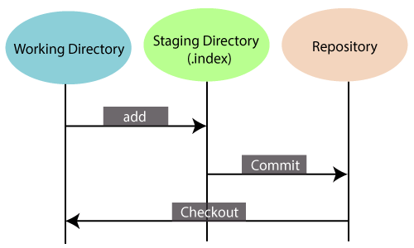
Starting area:
The Staging area is also a unique functionality of Git.
It can be considered as a preview of our next commit, moreover, an intermediate area where commits can be formatted and reviewed before completion.

Slide 11
Maintain clean history:
Git facilitates with Git Rebase; It is one of the most helpful features of Git.
It fetches the latest commits from the master branch and puts our code on top of that.
It maintains a clean history of the project.

Slide 12
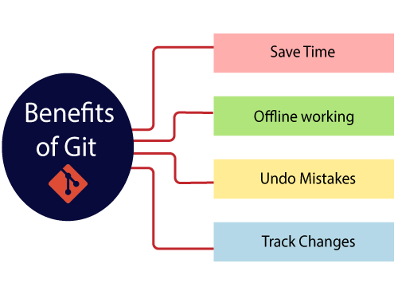

Slide 13
Git bash
1) Git - The collection of command line programs that makes up the Git version control system. (2) Bash - The name of a popular default shell on macOS and Linux. This means that the Git Bash package not only installs Git, but also the Bash shell and some important utilities for Bash.
Git Bash is a command-line interface for the Git version control system that provides a Unix-like environment on Windows. It allows you to use Git and run various Unix/Linux command-line utilities and tools in a Windows environment.

Slide 14
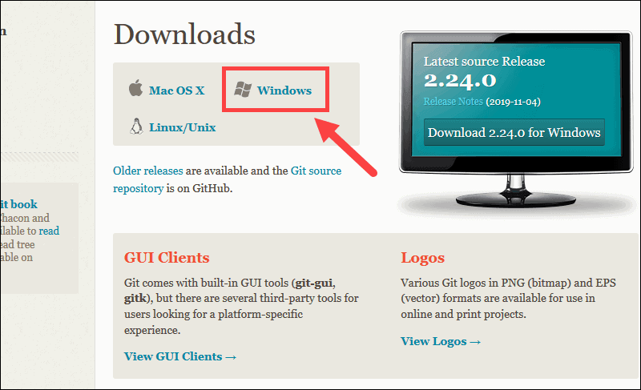
Git Bash - Installation
1. Browse to the official Git website: https://git-scm.com/downloads
2. Click the download link for Windows and allow the download to complete.
3. Install the Gitbash software

Slide 15
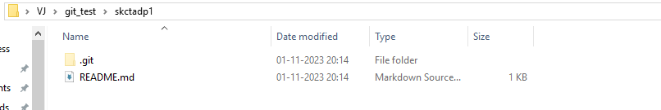
Git init
git init to Initialize local repository

Slide 16
To Create a new test directory (folder)
mkdir git_test
Change your location to the newly created directory
cd git_test
Now create a Github Account and Repository(folder) in Github.com

Slide 17
In Gitbash
Configure GitHub Credentials
git config --global user.name "github_username“
git config --global user.email "email_address“

Slide 18
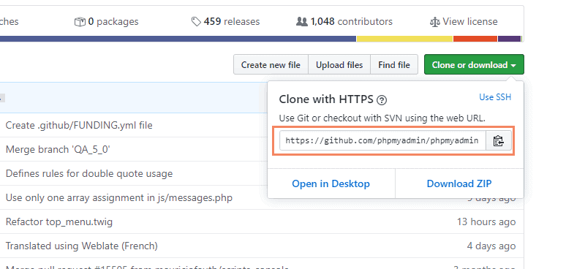
In Gitbash
Clone a GitHub Repository
Go to your repository on GitHub. In the top right above the list of files, open the Clone or download drop-down menu. Copy the URL for cloning over HTTPS

Slide 19
In Gitbash
List Remote Repositories
Your working directory should now have a copy of the repository from GitHub. It should contain a directory with the name of the project.
cd git_project
Create a File using Gitbash in Local Repo
nano t1.txt

Slide 20
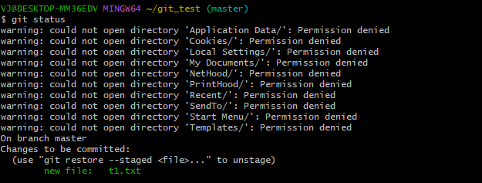
In Gitbash
Add your new file to the local repo
git add t1.txt
Run git status again to make sure the t1.txt file has been added.

Slide 21

In Gitbash
Next, commit the changes to the local project:
git commit -m "commiting text1.txt file"
Add a new remote repository
git remote add origin <repository_url>
git remote add origin https://github.com/vijaimail/skctadp1.git

Slide 22
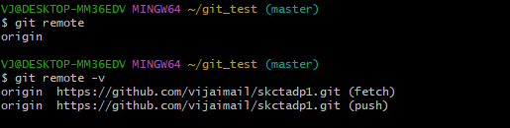
In Gitbash
To print current remote repo name,
git remote
git remote -v

Slide 23
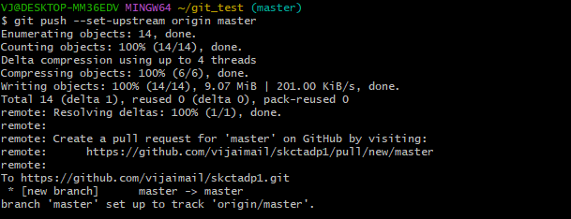
In Gitbash
The git push command is used in Git to push your local changes (commits) to a remote Git repository, when you want to update a remote repository with your local changes.
syntax- git push <remote> <branch>
git push origin main
git push --set-upstream origin master

Slide 24
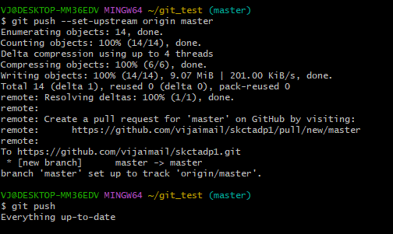
In Gitbash
After Git push, without making changes in local file , if you try to push again, it will show everything is up to date

Slide 25
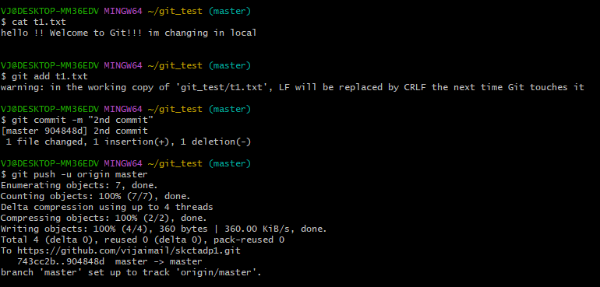
In Gitbash
After Git push, after making changes in local file -> adding -> Commiting -> doing Git push

Slide 26
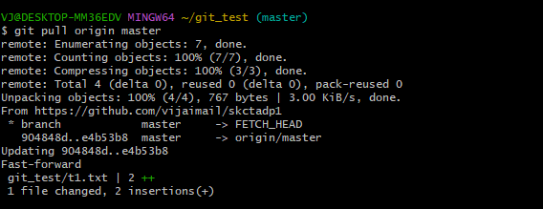
In Gitbash
git pull command is used to update your local Git repository with changes from a remote repository. It essentially performs two operations: it fetches the changes from the remote repository and then merges them into your current local branch.
If any changes made in remote repository, and changes needed to be updated in local repository. Git pull =fetch from remote repo + merge with local repo
Syntax
git pull <remote> <branch>
Example
git pull origin master

Slide 27
Git Checkout
The git checkout command in Git is used for various purposes, primarily for switching between branches, creating new branches, and checking out specific commits or files
Switch to a Branch: git checkout <branch-name>
Create a New Branch and Switch to It:git checkout -b <new-branch-name>
Checkout a File from Another Branch or Commit:
to copy a file named "example.txt" from the "feature-branch" into the current branch, git checkout feature-branch -- example.txt
Switch to the Previous Branch: git checkout –
To view Commiting history in current branch: git branch -vv

Slide 28
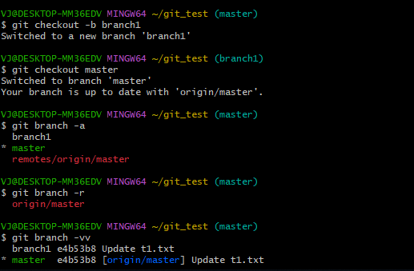
Git Checkout - Example

Slide 29
Git Checkout
The git checkout command in Git is used for various purposes, primarily for switching between branches, creating new branches, and checking out specific commits or files
Switch to a Branch: git checkout <branch-name>
Create a New Branch and Switch to It:git checkout -b <new-branch-name>
Checkout a File from Another Branch or Commit:
to copy a file named "example.txt" from the "feature-branch" into the current branch, git checkout feature-branch -- example.txt
Switch to the Previous Branch: git checkout –
To view Commiting history in current branch: git branch -vv

Slide 30
git merge
The git merge command is used in Git to combine changes from one branch into another. This is typically used when you have multiple branches in your Git repository and you want to integrate the changes made in one branch into another.
git merge <branch_to_merge>
<branch_to_merge> is the name of the branch from which you want to merge changes into your current branch

Slide 31
Netlify
Webhosting
https://app.netlify.com/start

